Slide 1
Virtual Memory
Types of Question can be made

Slide 2
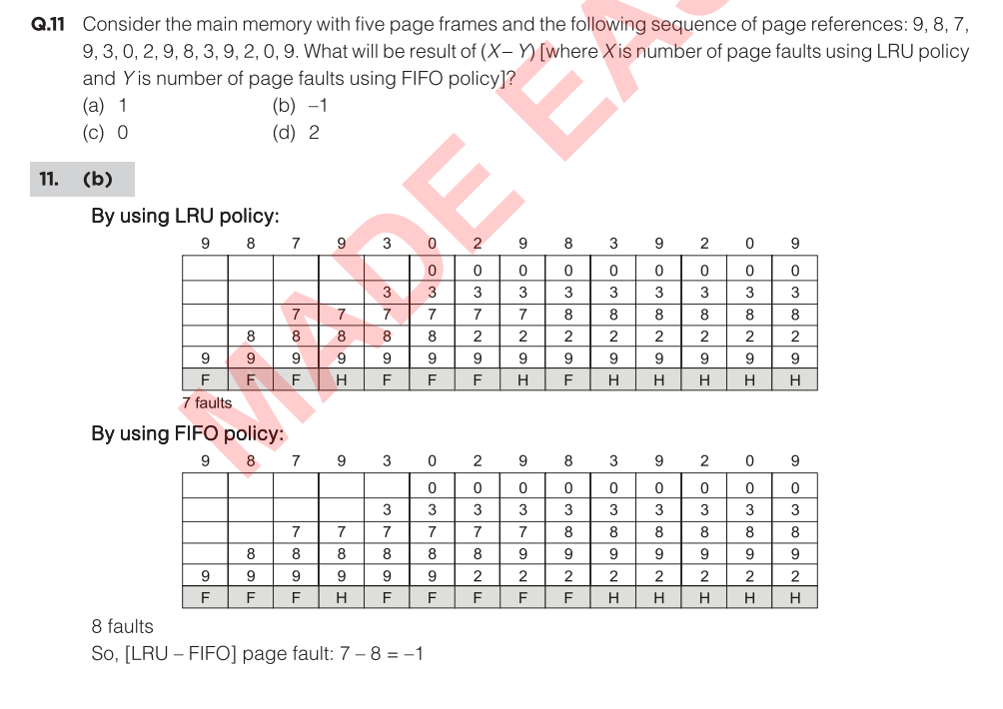

Slide 3
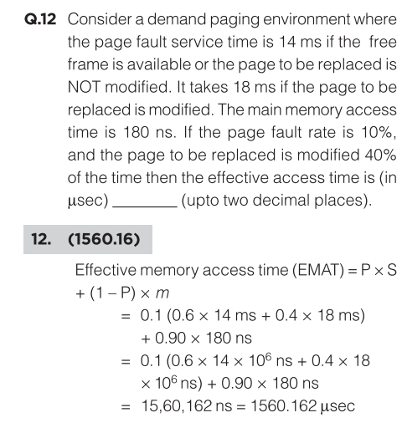

Slide 4
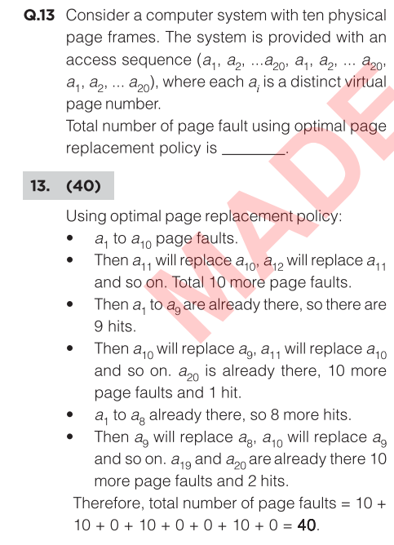
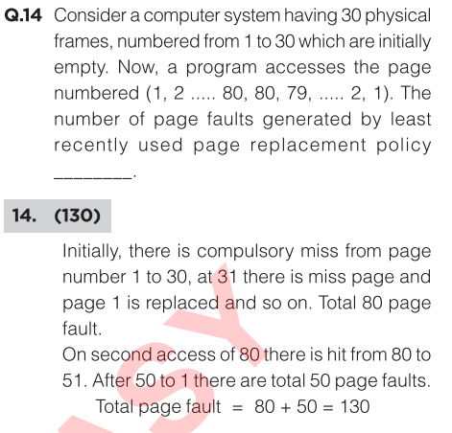

Slide 5
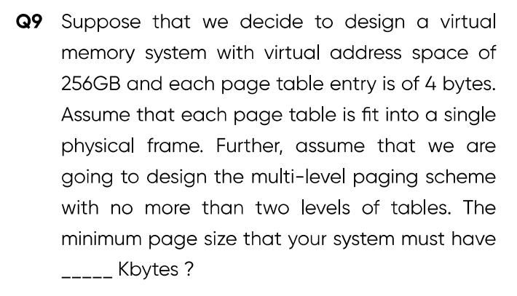
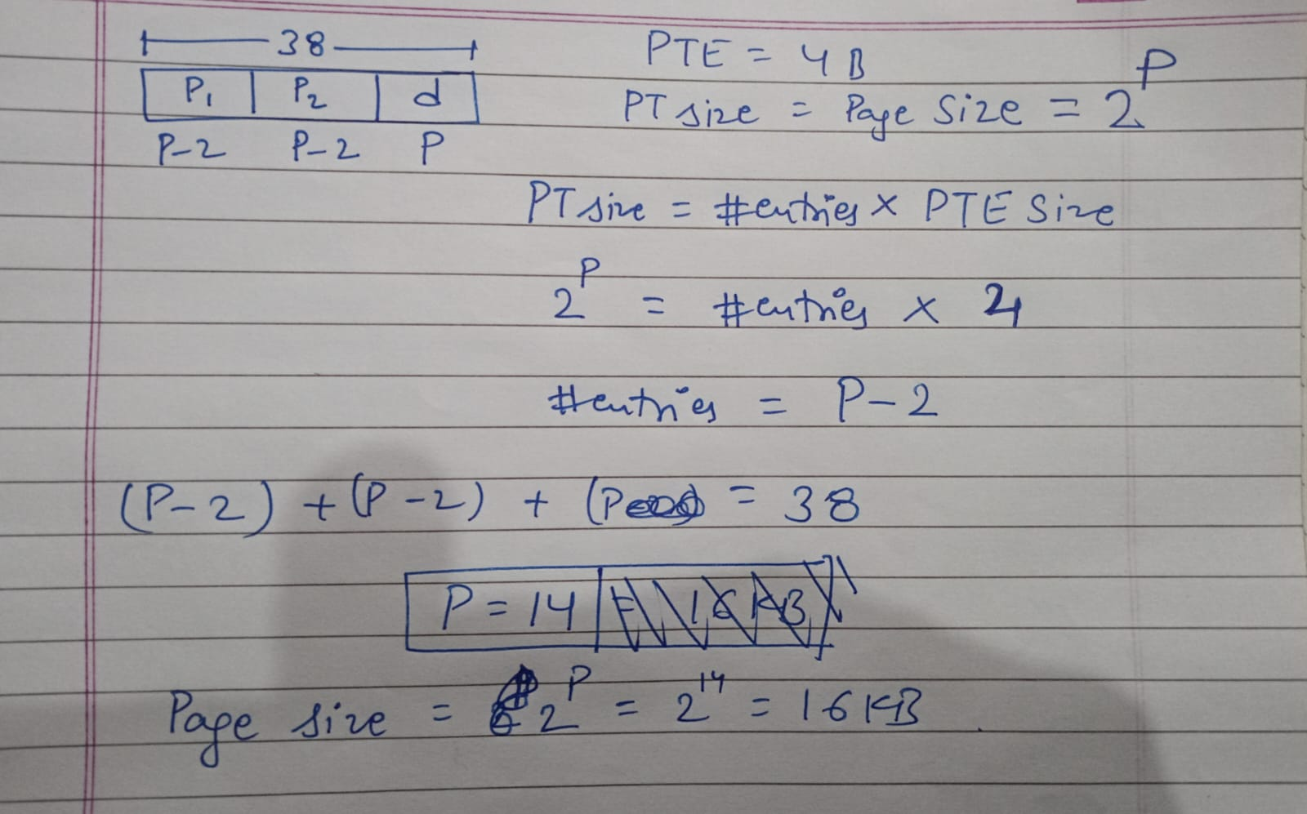

Slide 6
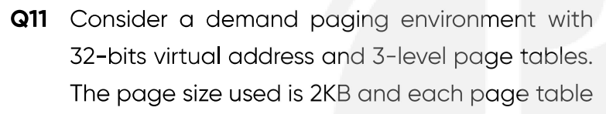
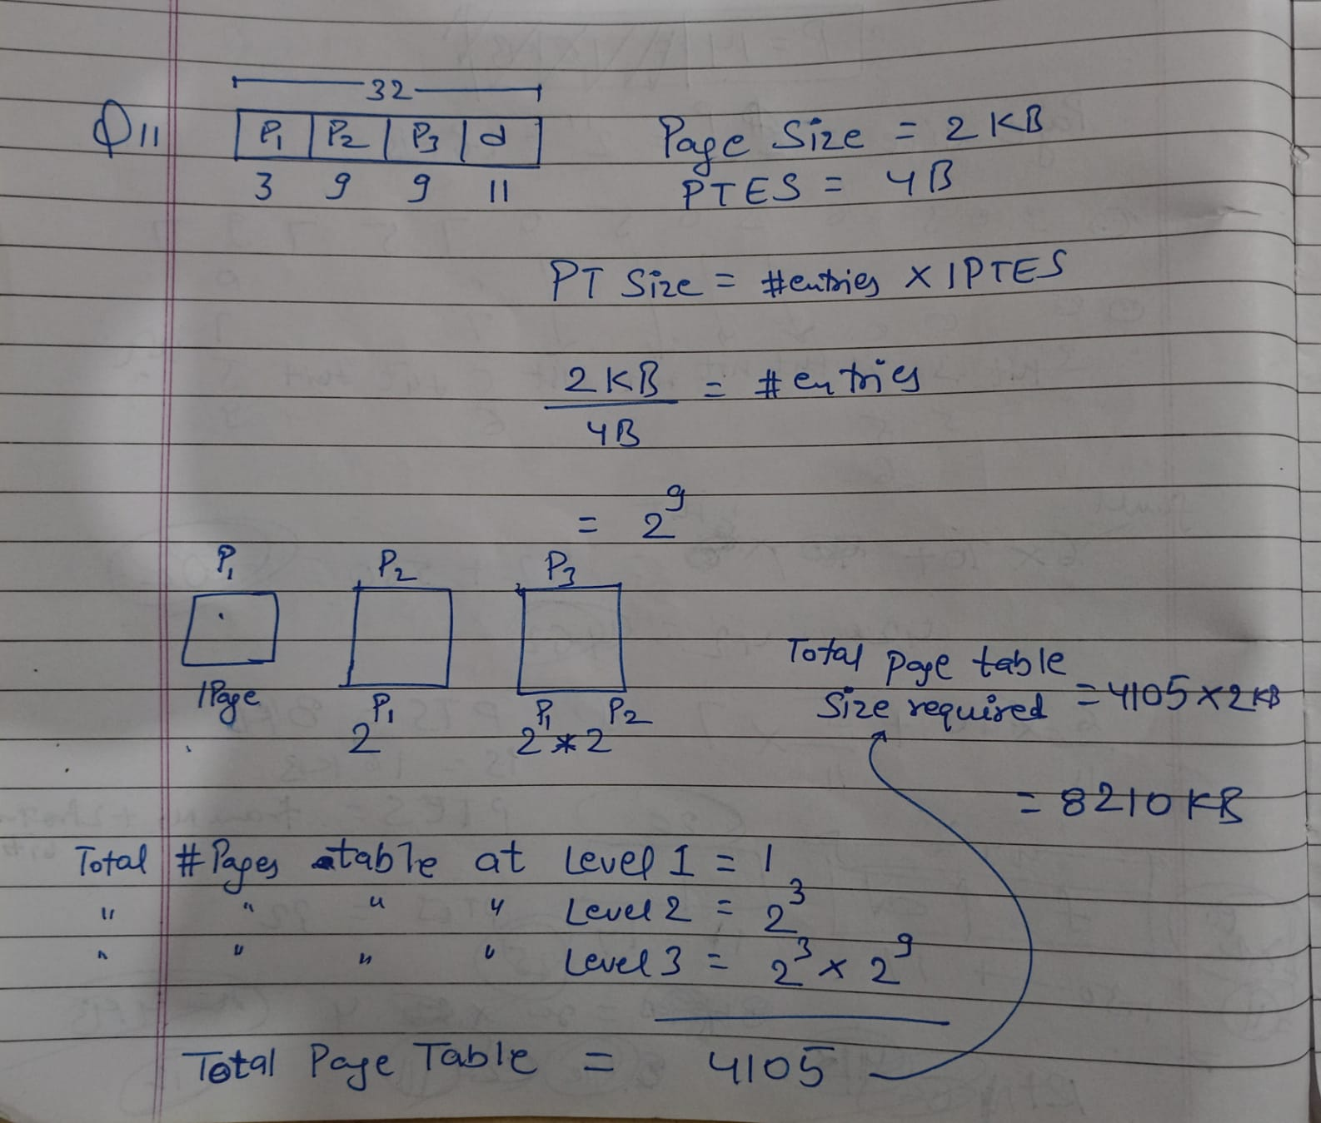
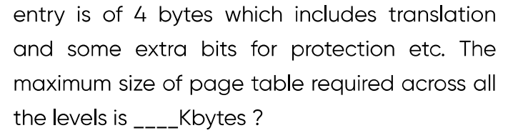

Slide 7
Theory
Belady’s anomaly refers to the situation where increasing the number of page frames increases the page fault rate.
Thrashing is a condition in an operating system where the CPU spends more time swapping pages in and out of memory than executing actual processes. Thrashing cannot always be avoided by swapping.
Paging divides memory into fixed-size pages → last page of a process may be partly unused → internal fragmentation.
Segmentation allocates variable-sized segments → free memory becomes split into holes → external fragmentation.
A page table entry (PTE) stores the frame number (and control bits: valid, dirty, protection, etc.).
The virtual page number is implicit (it’s the index into the page table), so it is not normally stored in each PTE. (See whiteboard Notes Diagram)

Slide 9
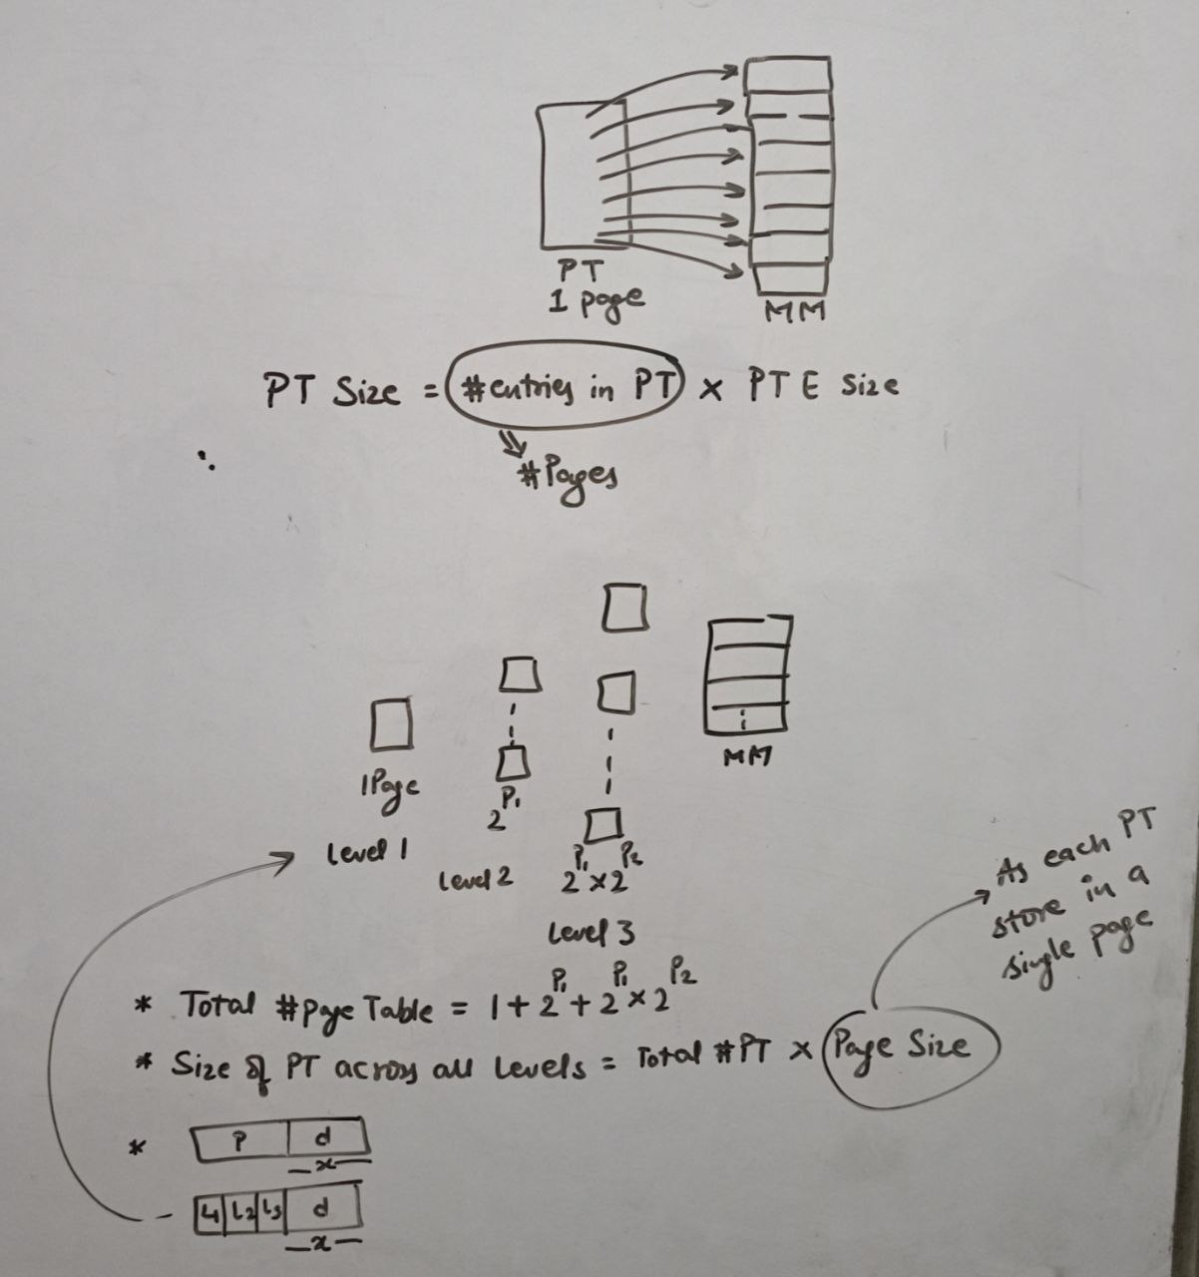

Slide 10
Thank You

